Slide 1


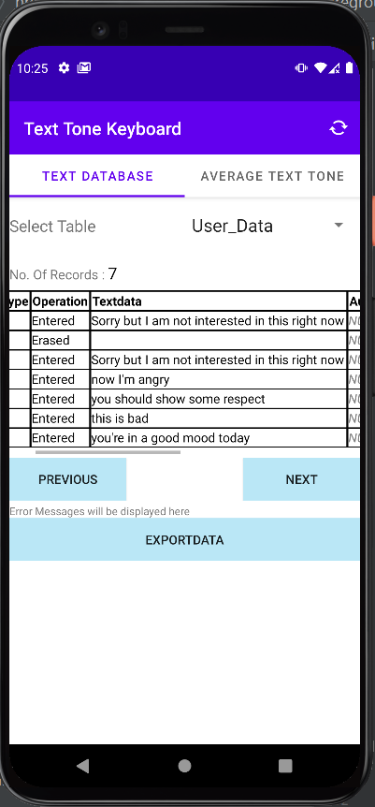
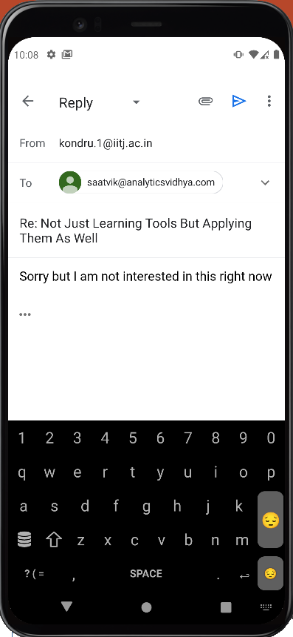
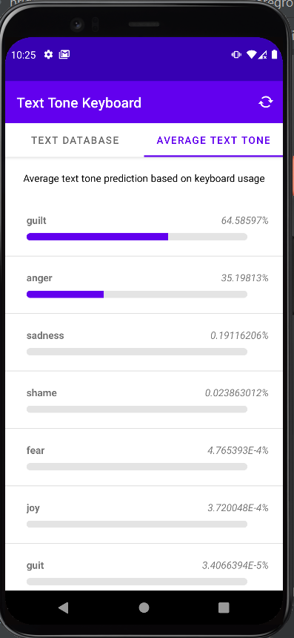







AI Text Tone Keyboard
Project by Hriday Kondru, 2nd Yr B.Tech CS, under guidance of Dr. Sumit Kalra, Assistant Professor, CS
About The App
This project is an Android keyboard that visually update the user in real time on the tone of the sentences being typed. The keyboard displays various emojis representing the mood of the sentences and hence the mood of the user. The Android app also persists the text typed by the user and allows them to analyze their mood over an extended period of time.
Description
The keyboard uses TensorFlow Lite Model Maker “mobilebert_classifier” text classification model architecture which was trained on the International Survey on Emotion Antecedents and Reactions (ISEAR) dataset.
The ISEAR database constructed by the Swiss National Centre of Competence in Research and lead by Wallbott and Scherer consists of seven emotion labels (joy, sadness, fear, anger, guilt, disgust, and shame) obtained as a result of gathering series of data from cross-cultural questionnaire studies in 37 countries. Three thousand (3000) participants from varying cultural backgrounds were made to fill questionnaires about their experiences and reactions toward events. The final dataset reports a total of 7665 sentences labeled with emotions.
The trained model is imported into an android app and integrated with the keyboard component. The keyboard component intercepts the users input and feeds the input to the TensorFlow model for predicting the users mood. The mood is mapped to various emojis that are displayed on the keyboard.
The Android app also has functionality to persist the text typed by the user in an sqlite database and allows the user to analyse his mood over an extended period of time.
Next Steps
These are the tentative next steps for the project:
Publish on Play Store
Improve the usability of the keyboard by adding additional features like auto text completion, spelling checker, glide typing, themes, etc.
Build functionality to improve the accuracy of the model by allowing the user to provide feedback
Extend the keyboard with multilingual support
Enhance the model to include predictions for multiple languages
Support iOS environment
Further research to see if the apps mood analysis capability could be used as a metric to predict the probability of non-communicable diseases
Real-time text tone predictions
Contact
Dr. Sumit Kalra
Assistant Prof. CS IIT Jodhpur
sumitk@iitj.ac.in
Hriday Kondru
2nd Yr, CS IIT Jodhpur
kondru.1@iitj.ac.in
9398759998

